Slide 1
Memories and Emotional Travel
Kendall Costello, Tina Jiang, Andrea Shulman, Steve Weyns
Notes:
Memory formation
Change in memory over time
Memory record
Relationship bw memory and emotion

Slide 2
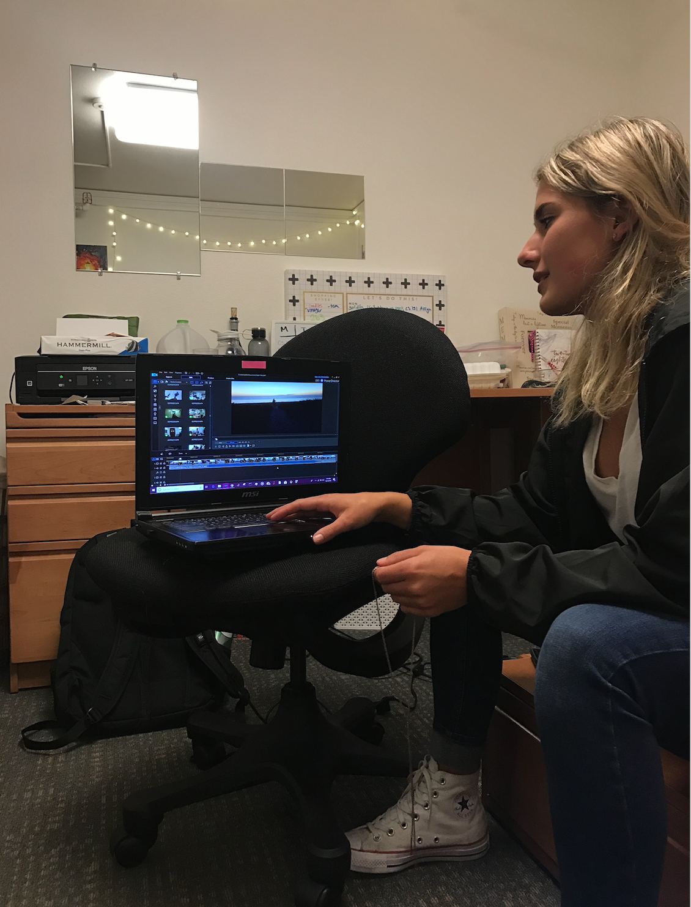
initial pov
We met Kasia
We were amazed to realize that... memory is extremely sensory, whereby songs and physical objects evoke certain emotions and feelings pertaining to that memory.
It would be game-changing to... give people a multimodal outlet to express their emotions.
Notes:
We will first take you through our..
We interviewed four people total
<super fast>

Slide 3
Interviews
Notes:
We will first take you through our..
We interviewed four people total
<super fast>

Slide 4
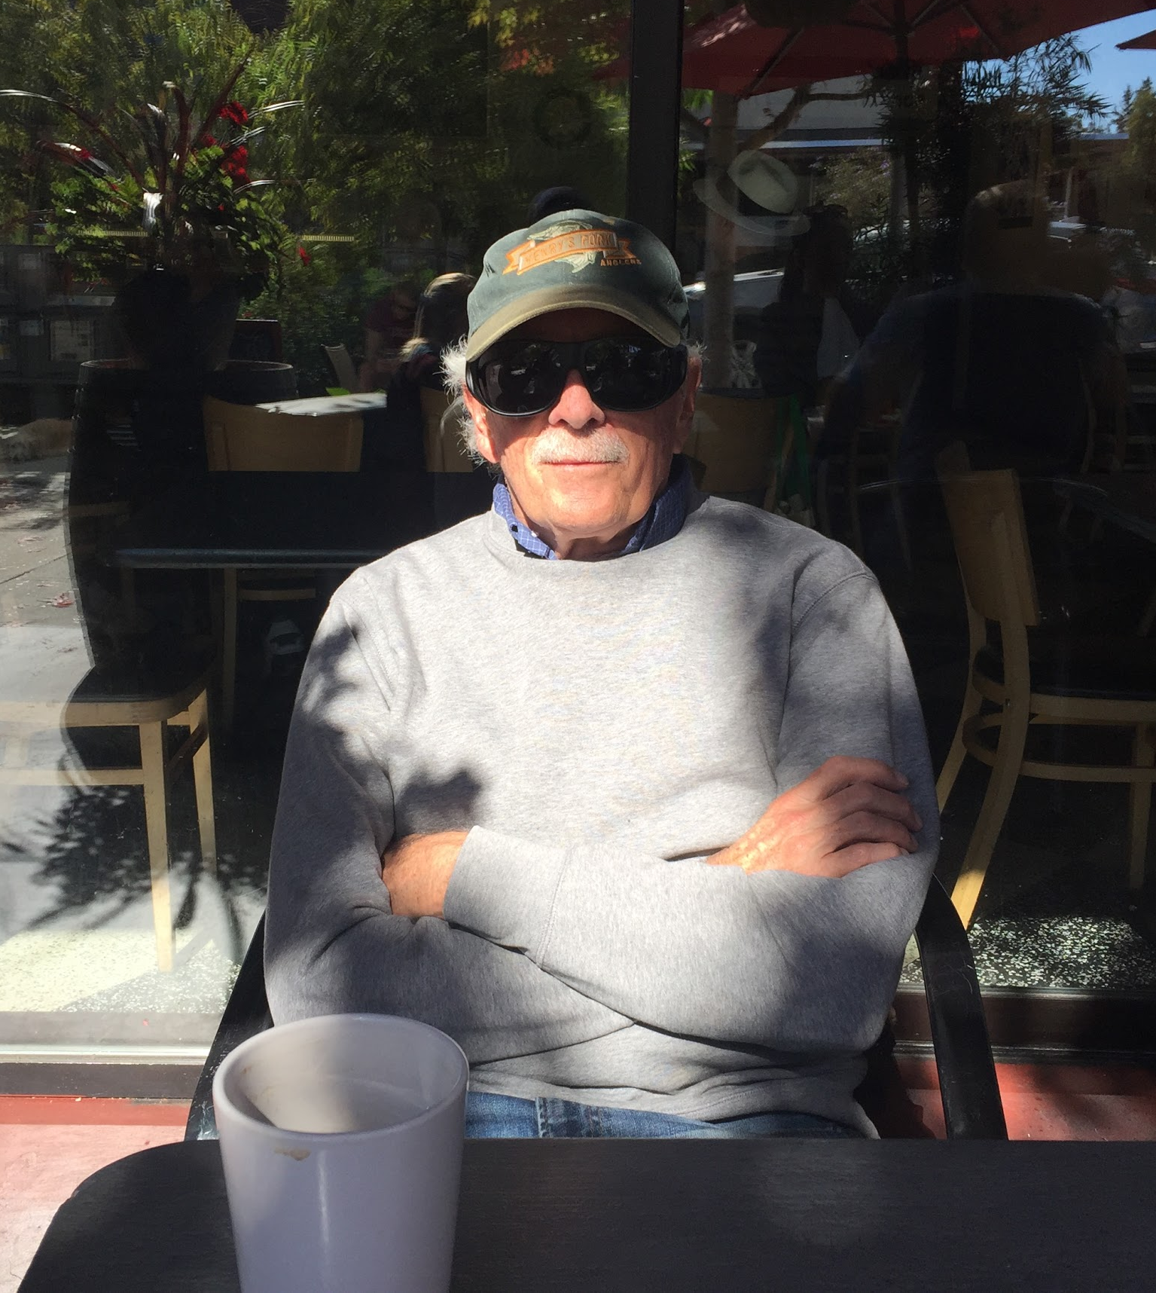
C. Barr Taylor
Psychiatrist in his 70s
“I didn’t realize how my drawings helped me firmly establish memories.”
Notes:
Psychiatrist, very interested in mental health space generally, worked on company called Lantern
He has always made drawings and doesn’t try to draw thing, tries to draw the experience, doesn’t focus on what he’s drawing really
Does it because he enjoyed it
When we talked to him, he realized it was connected to memory, didn’t think about that before

Slide 5
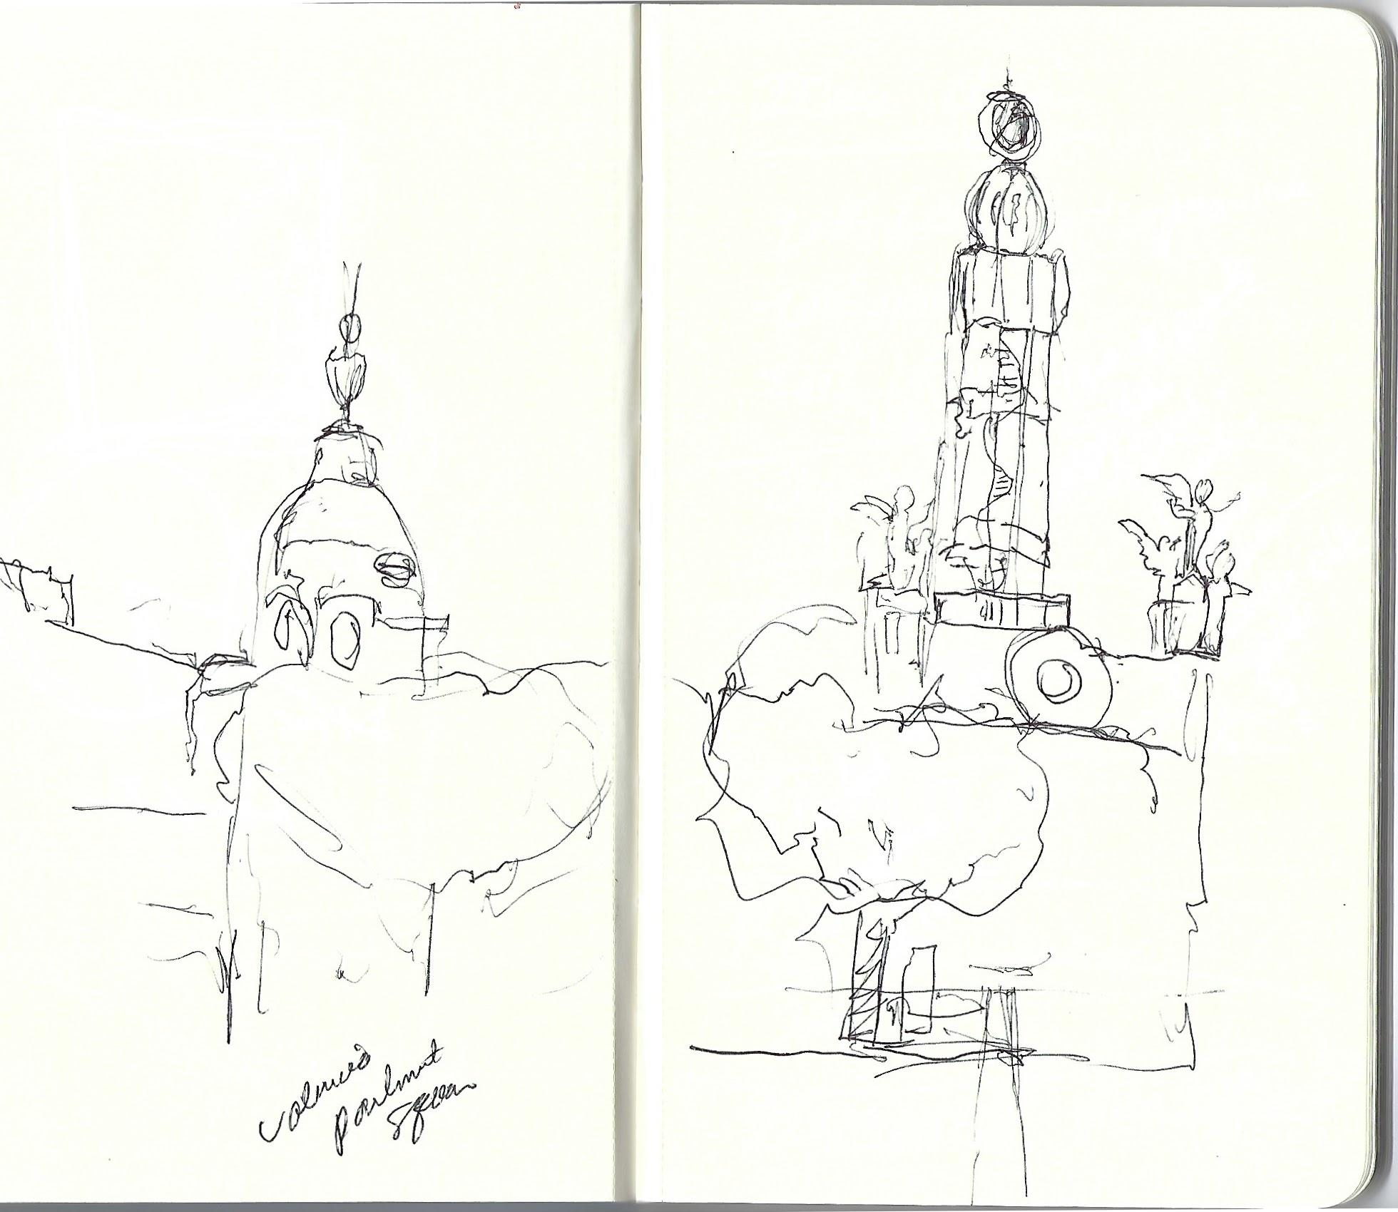
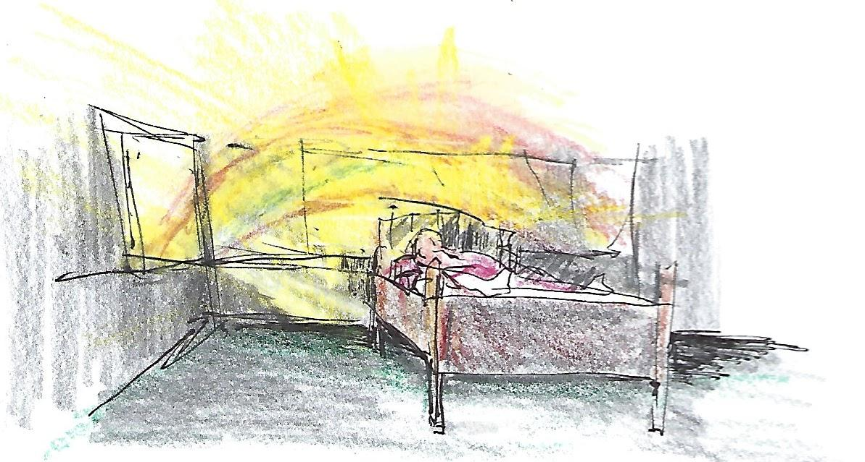
People don’t need physical artifacts after the memory is formed
Notes:
If we did something with these artifacts, it doesn’t really matter
He already subbcionciously processed, so doesn’t matter what do with picture
About process not result

Slide 6
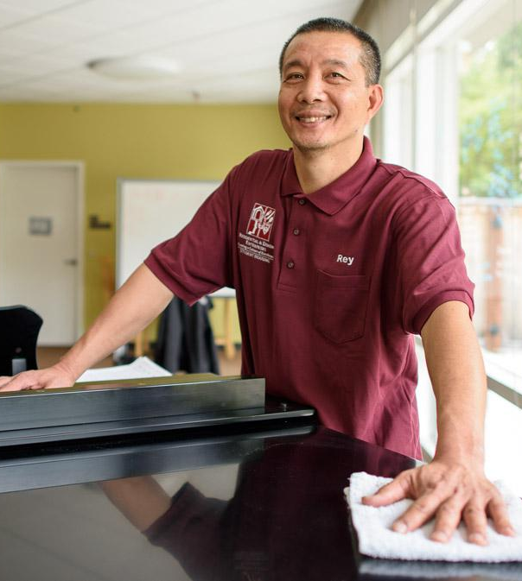
Rey Peralta
Long-serving custodian
“Memories help me remember what not to do.”
Notes:
Custodian, really focused on roles in his life, social roles (him as parent, grandparent now), how memories impact that
Not making same mistakes from memories
Interviewied because he sees people come and go, but doesn’t get to meet them all super well
He keeps notes of gift cards and stuff people give to him
He remembers but wouldn’t explain the details

Slide 7
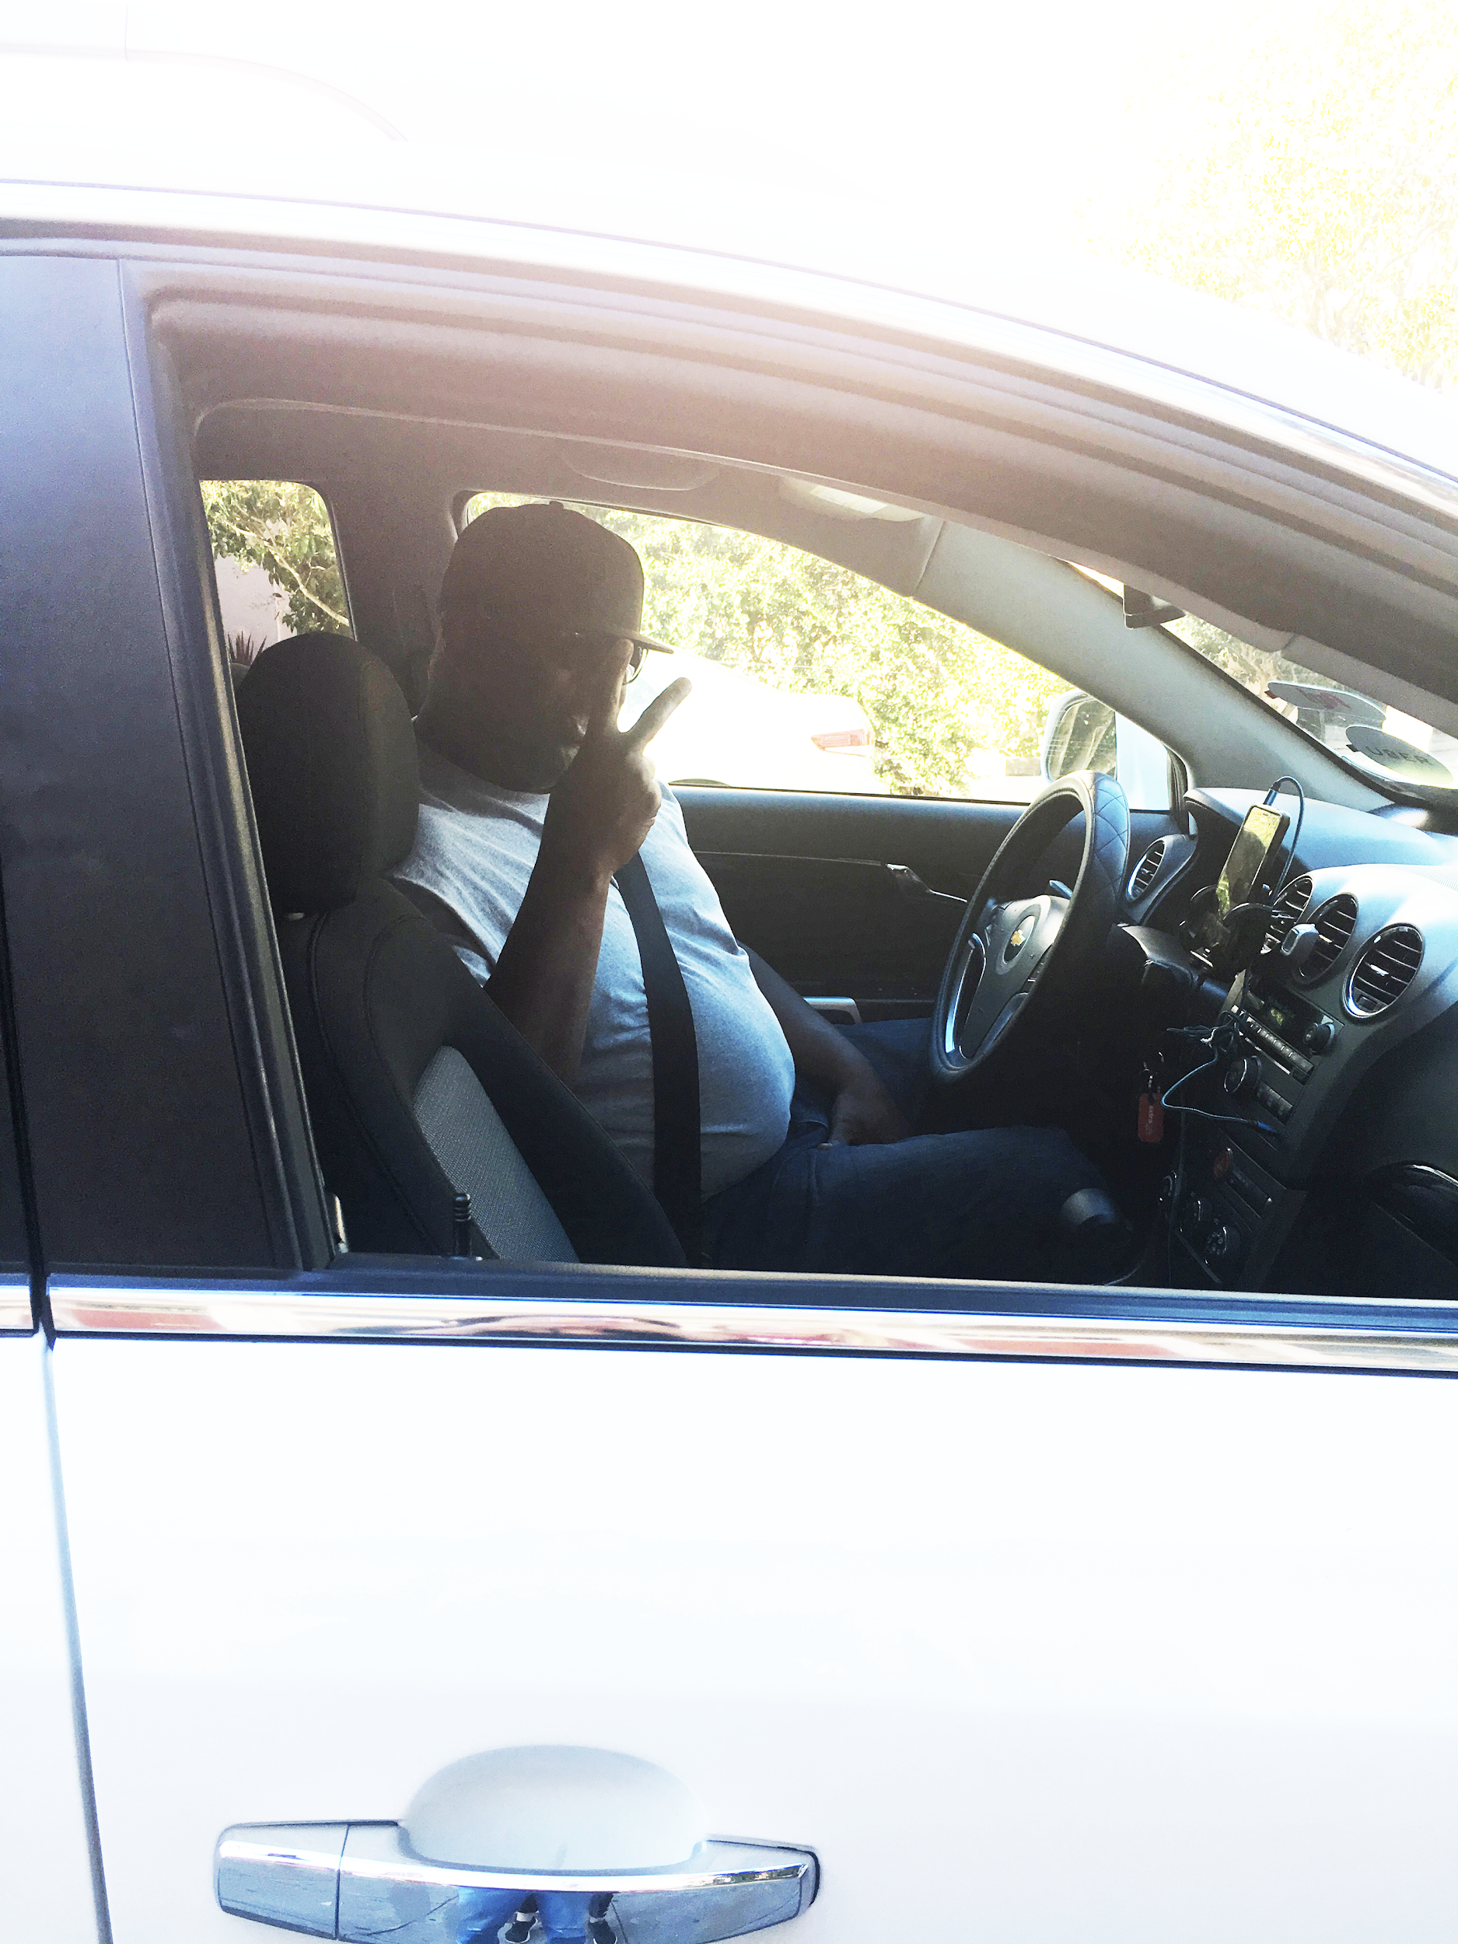
Michael
Lyft Driver
“It’s hard to remember people when you only see a blur of their face in the mirror.”
Notes:
Lyft driver, sees lots of deaths

Slide 8
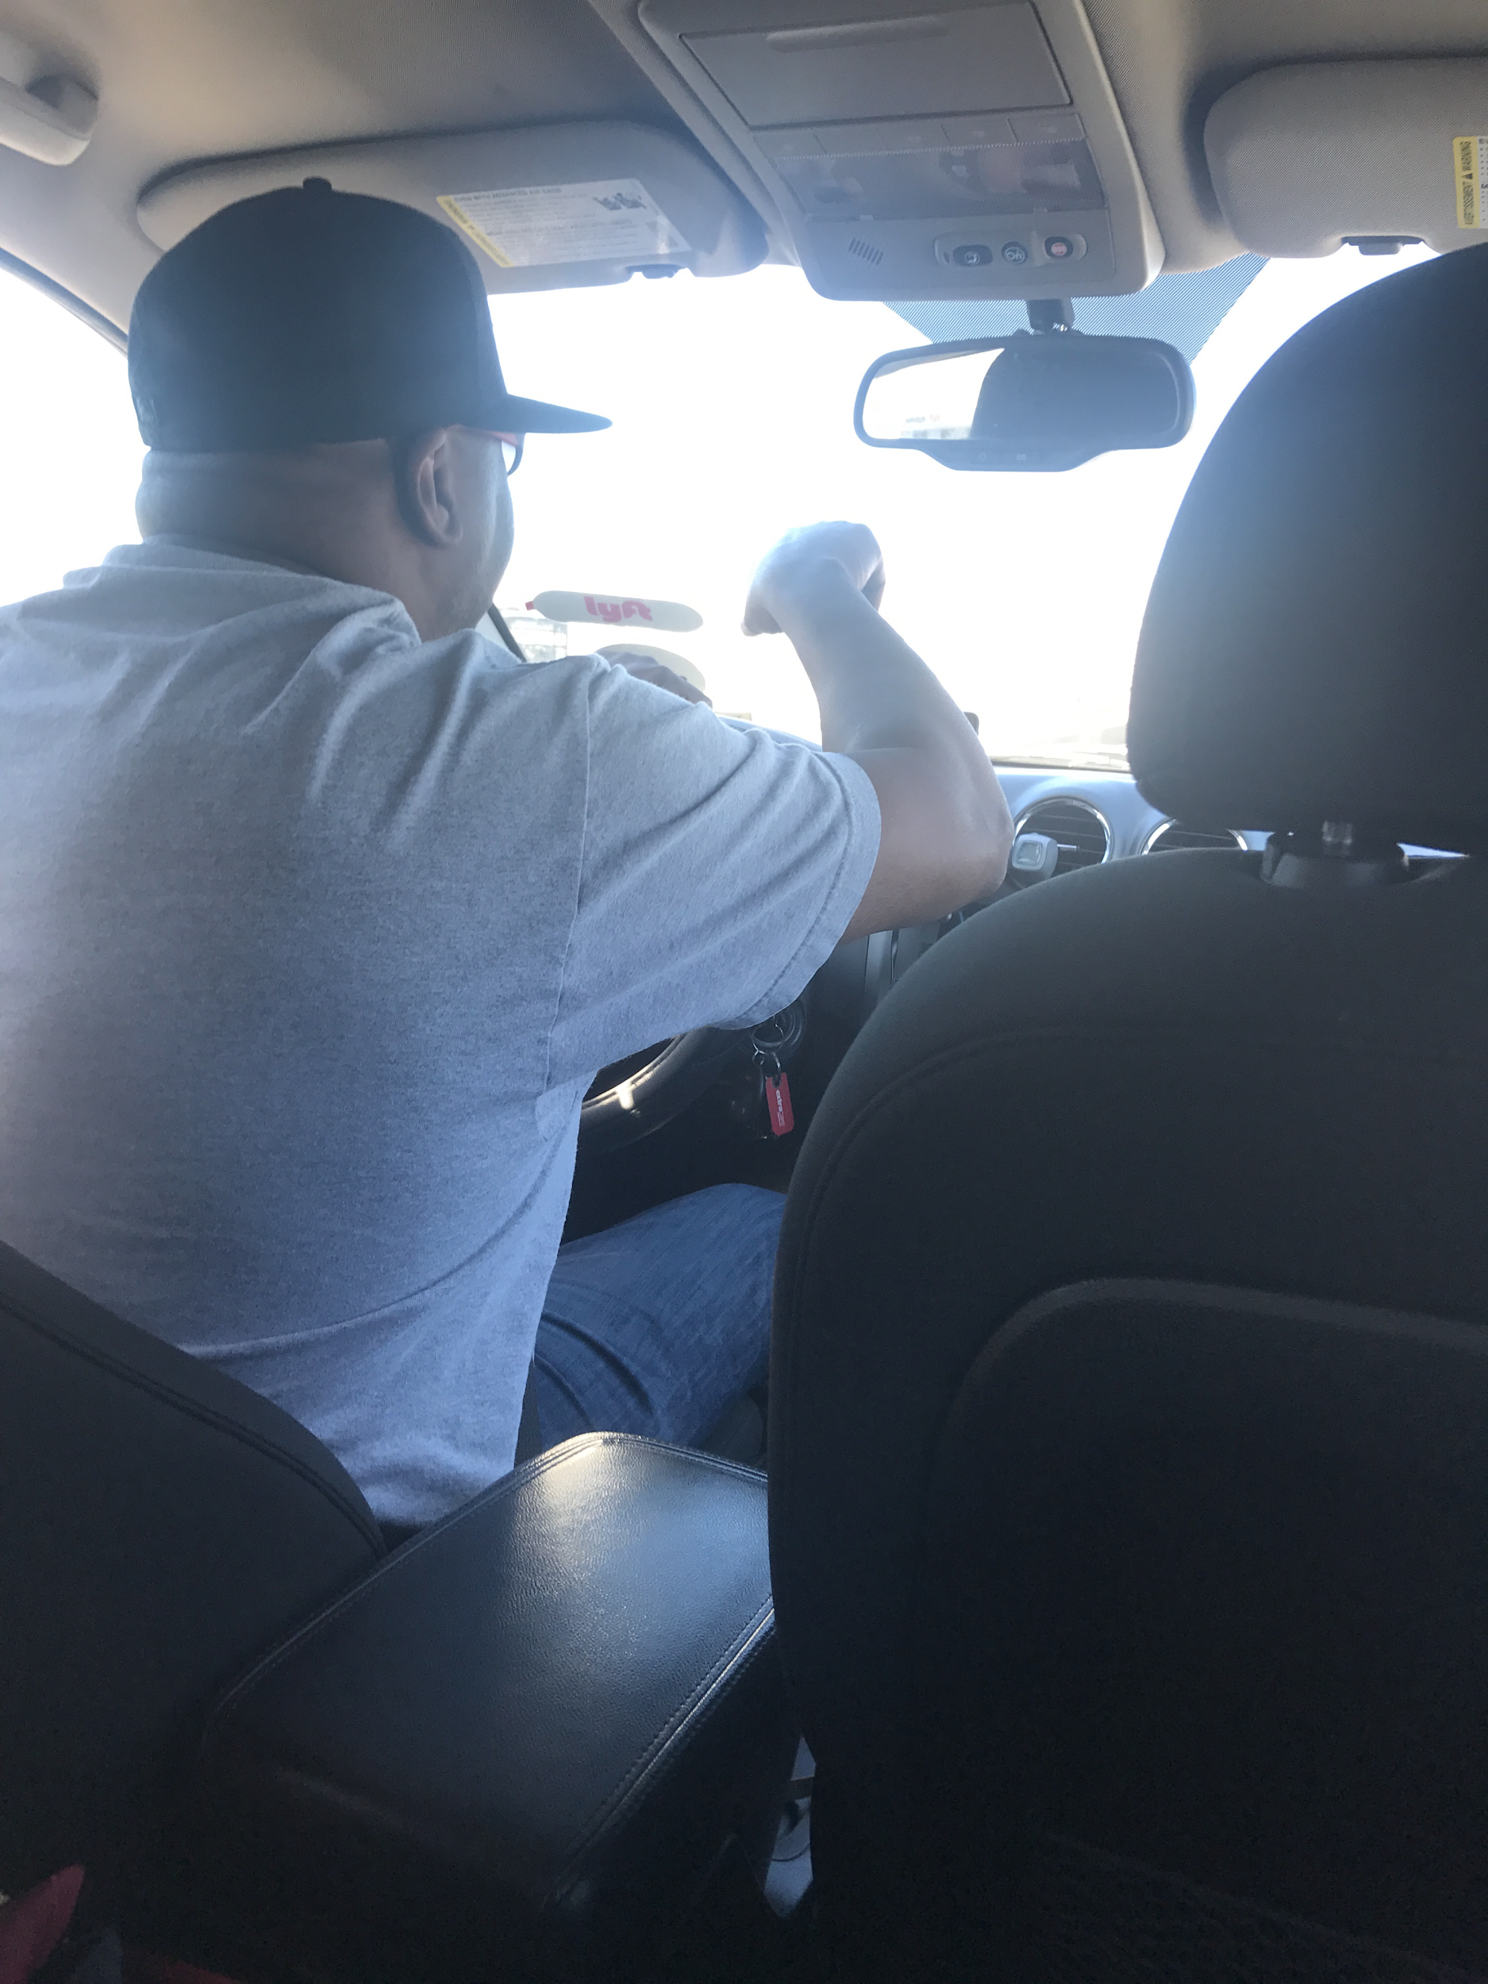
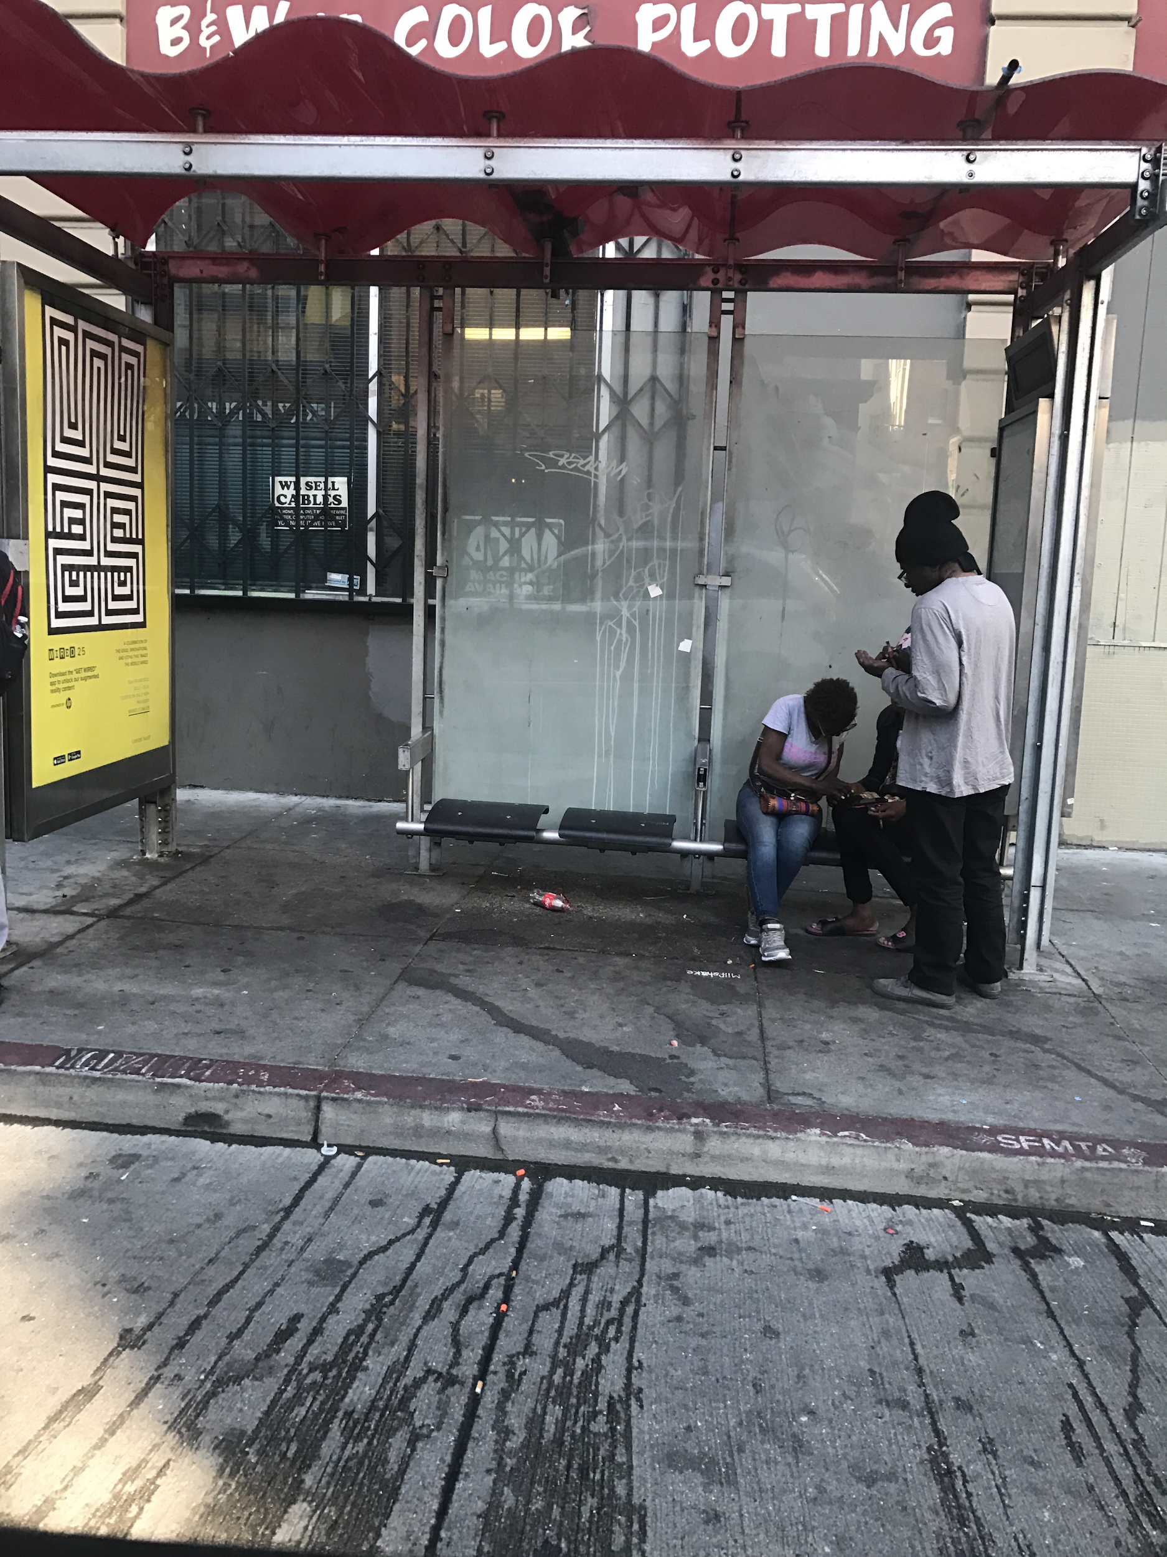
Physical locations conjure memories

Slide 9
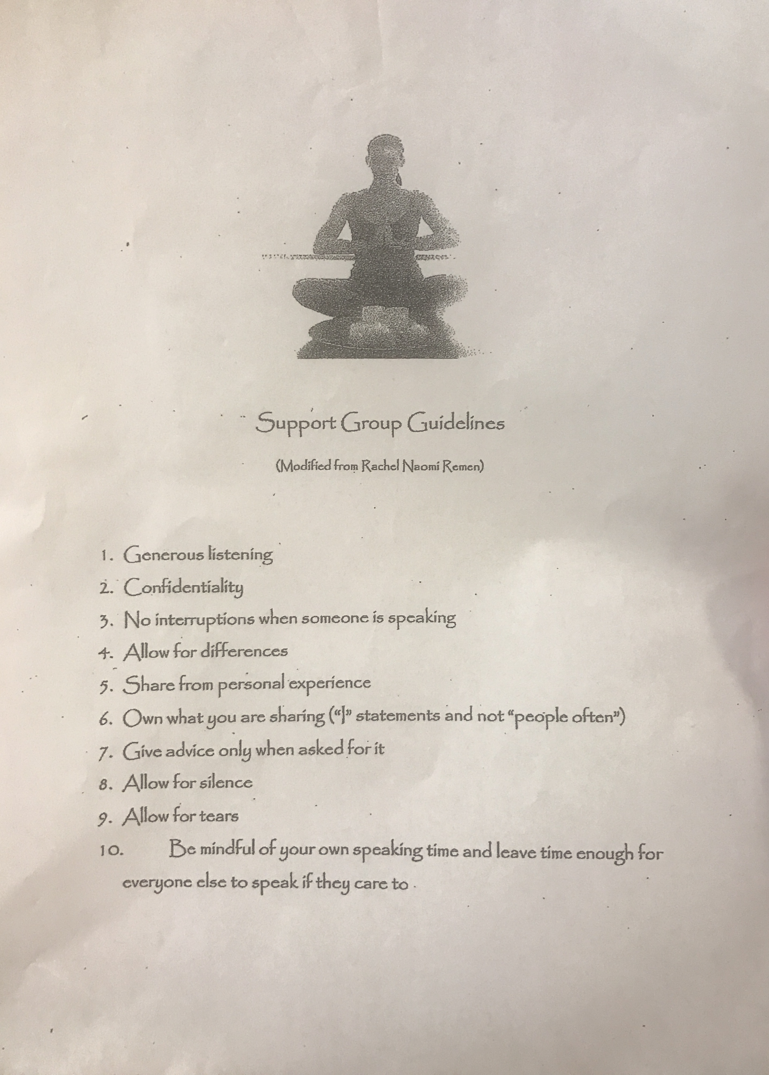
Death Cafe
Support group attendees
“I live more in the past then the present.”
Notes:
People open up when prompted

Slide 10
Revised POV’s
Notes:
We will first take you through our..
We interviewed four people total
<super fast>

Slide 11
We met...
Kasia, an amateur Youtuber who creates monthly montages of her past notable experiences and keeps a personal journal to
reflect on her daily experiences.
We were amazed to realize that...
Kasia can evoke clearer feelings, emotions, and sensations in herself from the songs, images, and physical objects she
associates with specific memories.
It would be game-changing to...
give people a multimodal outlet to attempt to refeel specific experiences.
Notes:
The initial one was very general, this is more specific to what kasia was doing

Slide 12

It would be game-changing to... give people a multimodal outlet to attempt to refeel specific experiences.
Notes:
We will first take you through our..
We interviewed four people total
<super fast>

Slide 13
It would be game-changing to... give people a multimodal outlet to attempt to refeel specific experiences.
Incentivize people to consistently record experiences?
Create nuggets of memory that encapsulate a sensory experience?
Combine multiple types of media as a coherent whole?
Notes:
We will first take you through our..
We interviewed four people total
<super fast>

Slide 14
It would be game-changing to... give people a multimodal outlet to attempt to refeel specific experiences.
Incentivize people to consistently record experiences?
Create nuggets of memory that encapsulate a sensory experience?
Combine multiple types of media as a coherent whole?
Notes:
We will first take you through our..
We interviewed four people total
<super fast>

Slide 15
We met...
Michael, a full-time Lyft driver who knows the entire Bay Area “like the back of his hand.”
We were amazed to realize that...
Michael preferred to talk about his experiences with others to solidify their memories.
It would be game-changing to...
provide people with an “extro-spective” outlet to reflect out-loud about their personal thoughts, feelings, and emotions.
Notes:
We will first take you through our..
We interviewed four people total
<super fast>

Slide 16
It would be game-changing to... provide people with an “extro-spective” medium to reflect out-loud about their personal thoughts, feelings, and emotions.
Notes:
Extrospective means thinking outside of their head, definition in dictionary means observing outside world, what we mean is observe ourselves still but externally, have to share to process it

Slide 17
It would be game-changing to... provide people with an “extro-spective” medium to reflect out-loud about their personal thoughts, feelings, and emotions.
Be “extro-spective” without involving other people?
Make extrospective people more introspective or vice versa?
Create a comfortable environment to share memories?
Notes:
We will first take you through our..
We interviewed four people total
<super fast>

Slide 18
We met...
Barr, a psychiatrist in his early 70s.
We were amazed to realize that…
once he created intricate emotionally grounding drawings, it didn’t matter to him what happened to them.
It would be game-changing to…
be able to cement memories without keeping physical artifacts.
Notes:
We will first take you through our..
We interviewed four people total
<super fast>

Slide 19
It would be game-changing to... to be able to cement memories without keeping physical artifacts.
Notes:
We will first take you through our..
We interviewed four people total
<super fast>

Slide 20
It would be game-changing to... to be able to cement memories without keeping physical artifacts.
Use behavioral practices to cement memories?
Cement memories at the time of formation?
Make something physical feel fleeting?
Notes:
We will first take you through our..
We interviewed four people total
<super fast>

Slide 21
It would be game-changing to... to be able to cement memories without keeping physical artifacts.
Use behavioral practices to cement memories?
Cement memories at the time of formation?
Make something physical feel fleeting?
Notes:
We will first take you through our..
We interviewed four people total
<super fast>

Slide 22

HMW’s
Incentivize people to consistently record experiences?
Create nuggets of memory that encapsulate a sensory experience?
Cement memories at the time of formation?
Notes:
We will first take you through our..
We interviewed four people total
<super fast>

Slide 23
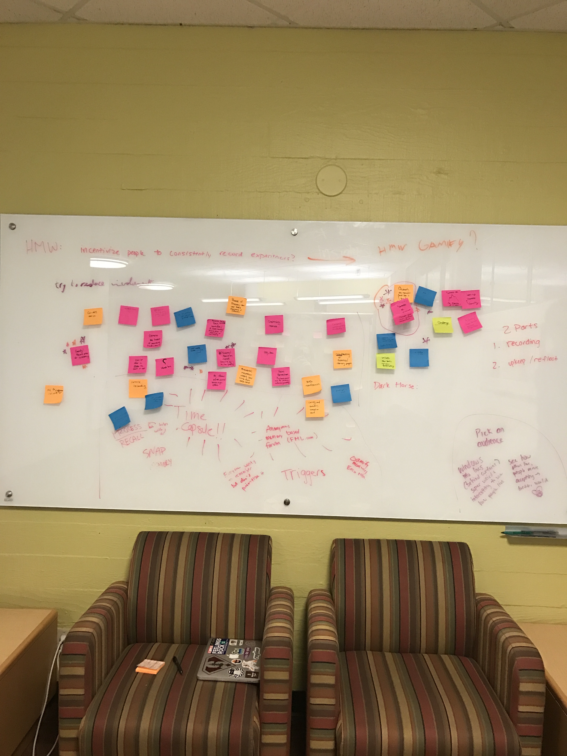
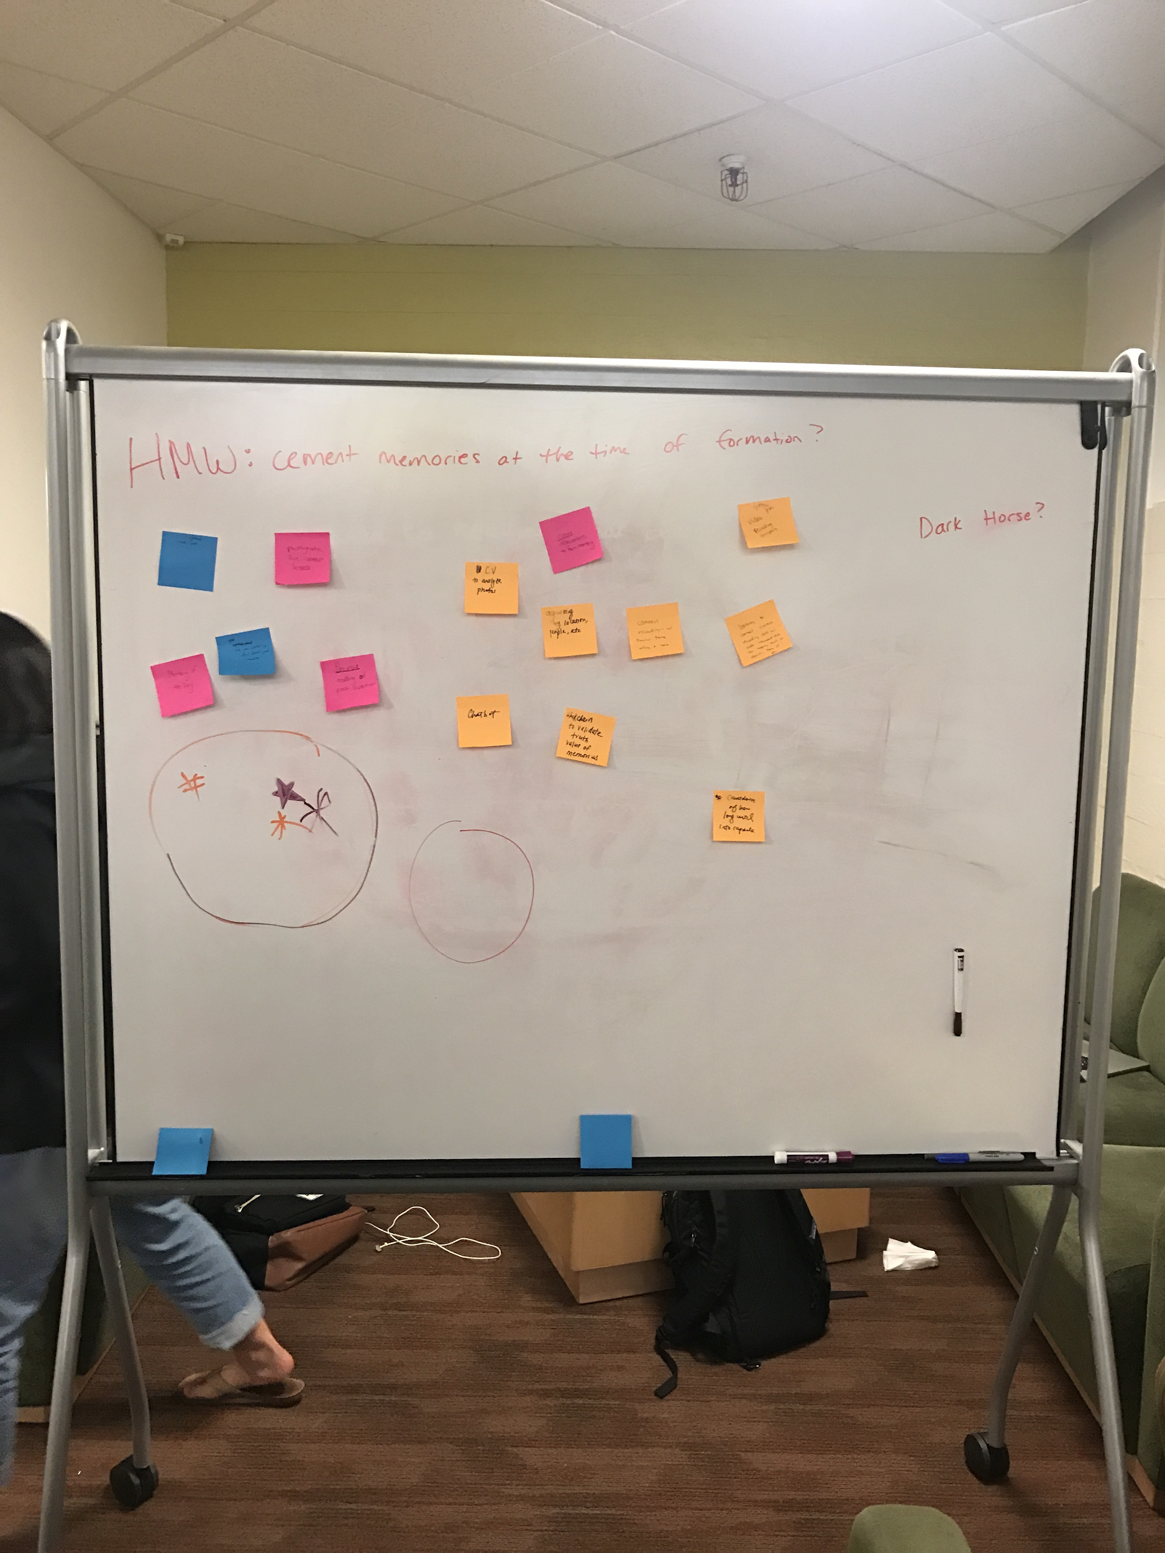
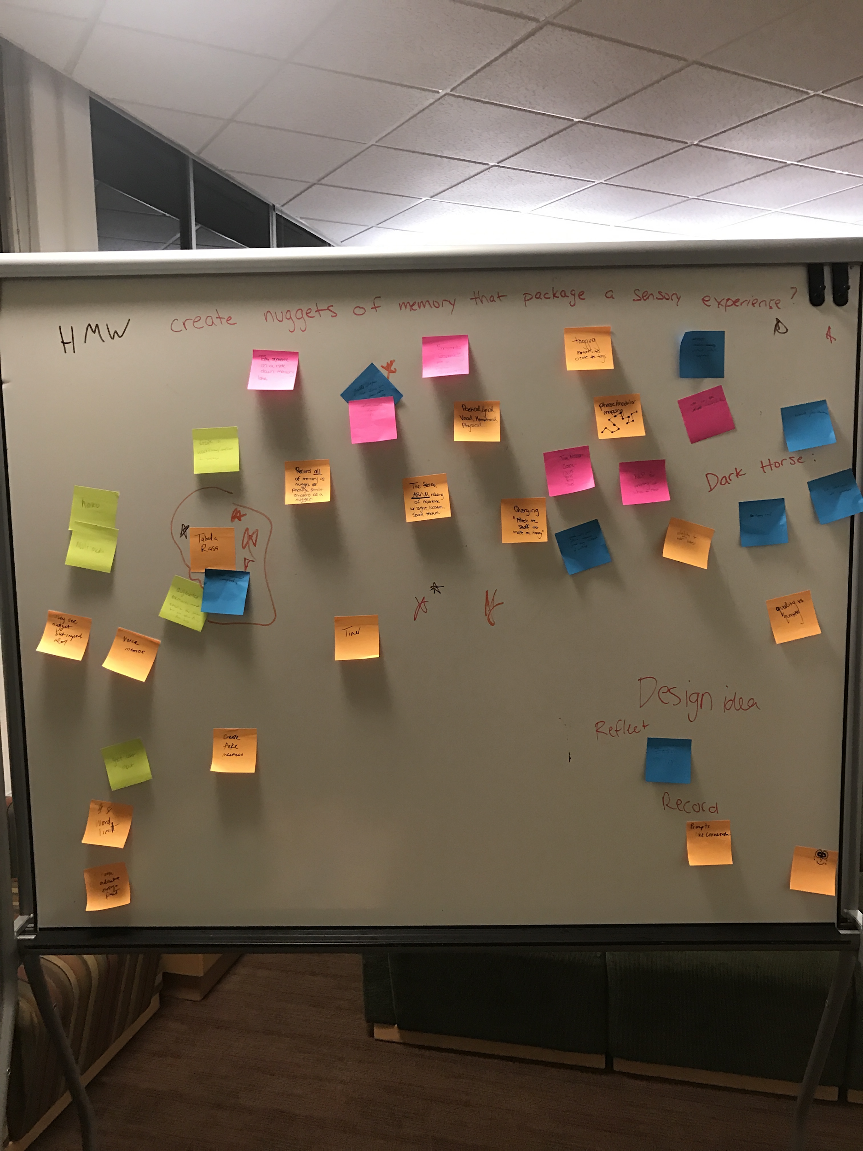
Notes:
Through emotional journey through time
The process of recall
happiest moment
- what do you do if you can’t rememeber
- are these memories still relevant

Slide 24
Experience Prototypes
Notes:
We will first take you through our..
We interviewed four people total
<super fast>

Slide 25
HMW: How might we cement memories at the time of formation?
A time capsule where recorded memories disappear for a given period of time.
Assumption: Transient artifacts result in more rewarding memory formation.
Notes:
Participant asked to physically express recent salient memory after being told they would never see their tangible creation again
Through emotional journey through time
The process of recall
happiest moment
- what do you do if you can’t rememeber
- are these memories still relevant

Slide 26
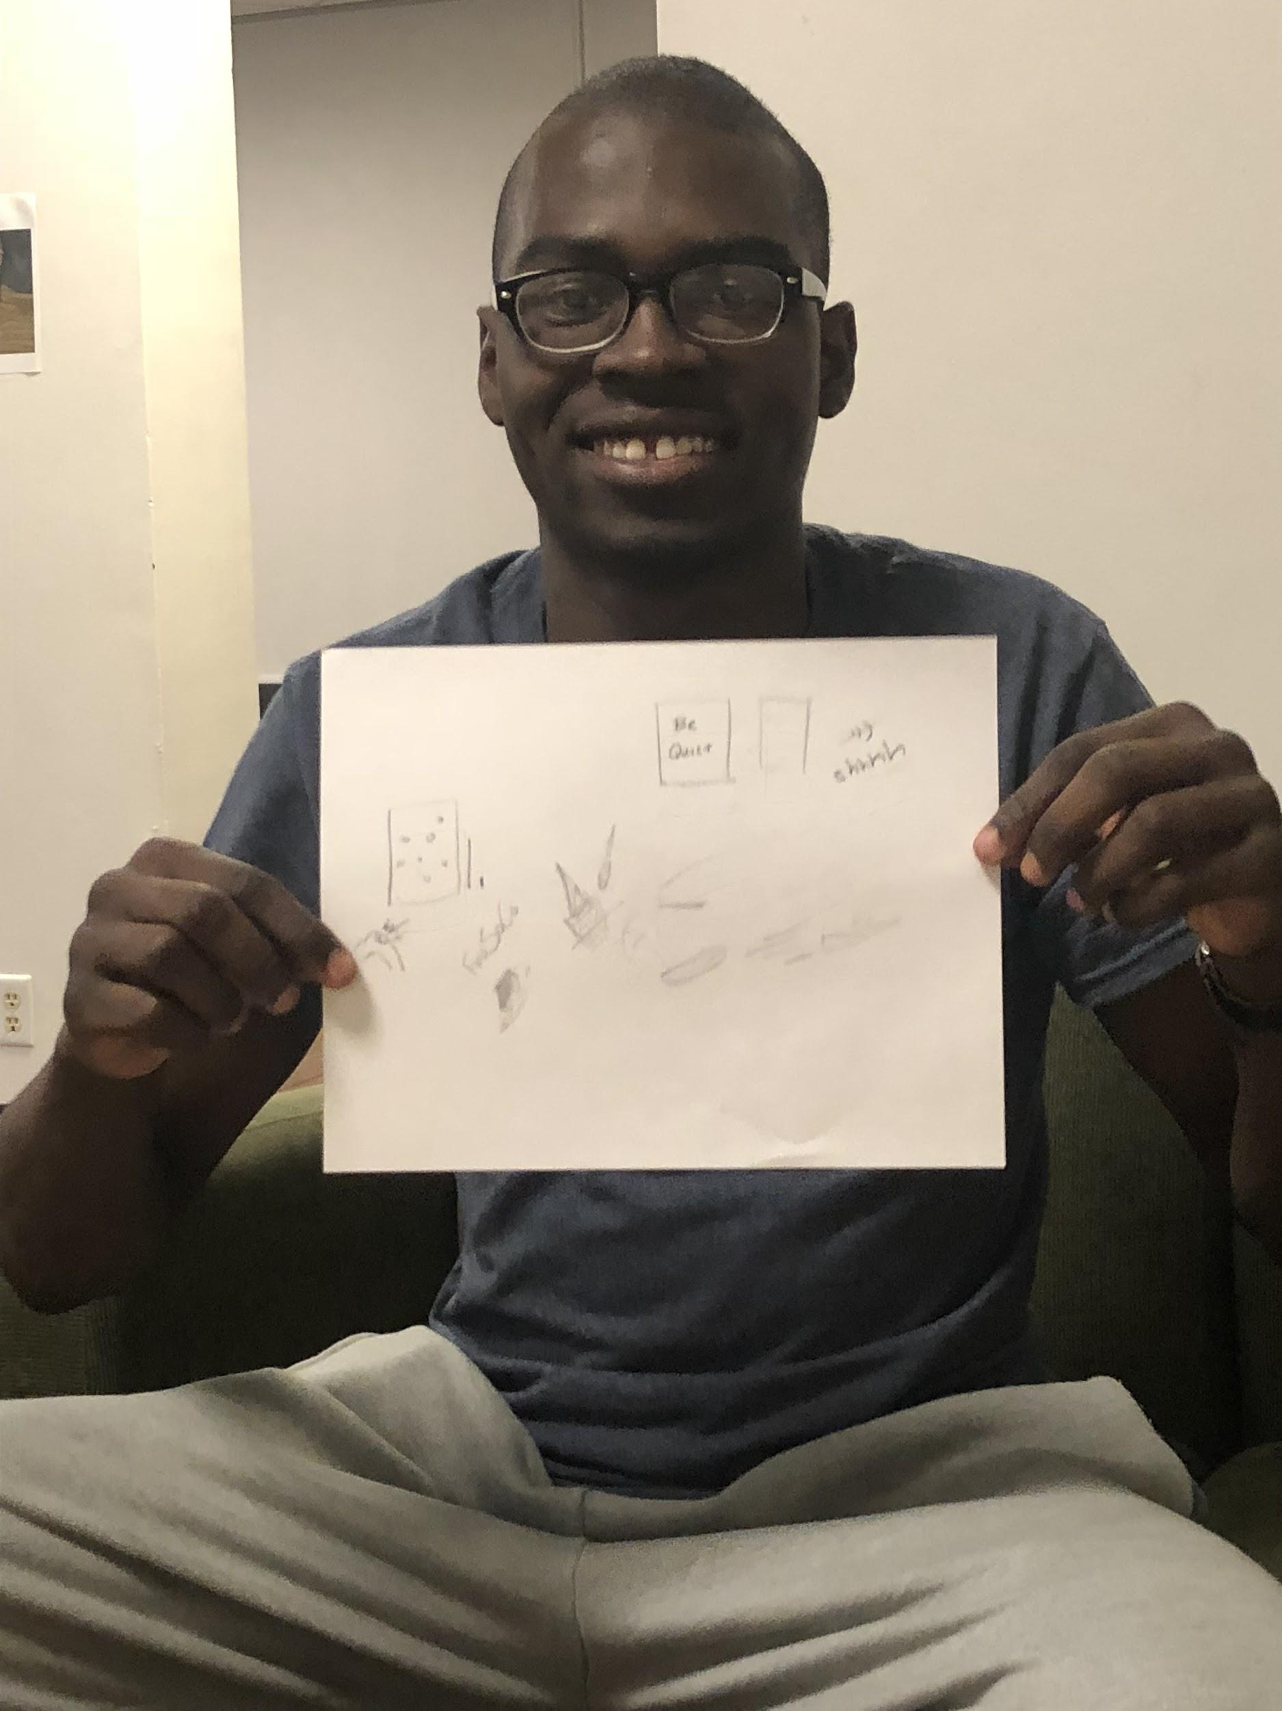
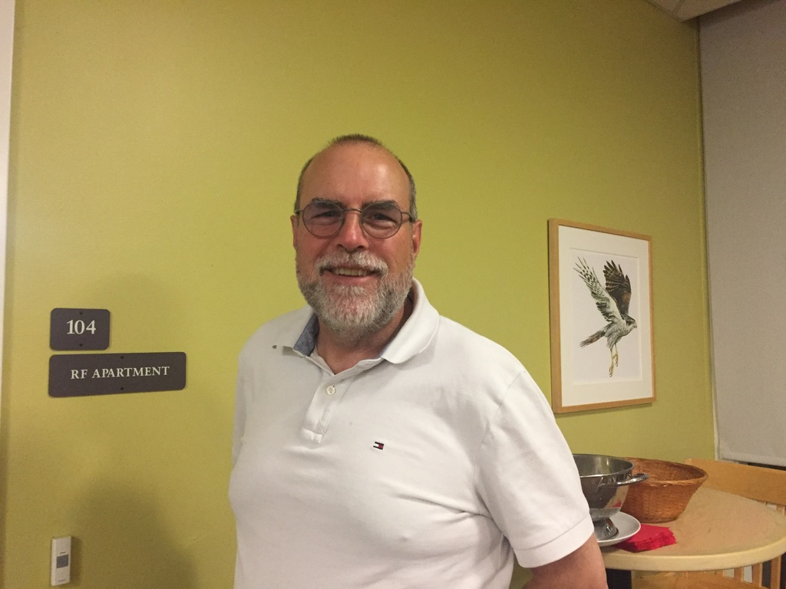
Notes:
John said that he did not mind if we took this photo from him forever. However, if someone were to take his sketchbooks that he has saved over the last 20 years, he would “be pretty pissed, but it wouldn’t be the end of the world.” He said that these were more important to him as they were a sort of catalog of his life.
Once an artifact of a memory is part of a larger collection/catalog, it holds more value and is more rewarding.

Slide 27
fun addition
transience is inconsequential
process enough to cement
The act of recording a memory is sufficient for cementing it.
no temporal aspect?
one-off vs collections
no value?
Notes:
John said that he did not mind if we took this photo from him forever. However, if someone were to take his sketchbooks that he has saved over the last 20 years, he would “be pretty pissed, but it wouldn’t be the end of the world.” He said that these were more important to him as they were a sort of catalog of his life.
Once an artifact of a memory is part of a larger collection/catalog, it holds more value and is more rewarding.

Slide 28
HMW: How might we create nuggets of memory that encapsulate a sensory experience?
A tabula rasa where people can record memories in any medium (photo, text, audio, video, song, etc.).
Assumption: People want the freedom to choose which medium they record their memories with.
Notes:
Through emotional journey through time
The process of recall
happiest moment
- what do you do if you can’t rememeber
- are these memories still relevant

Slide 29
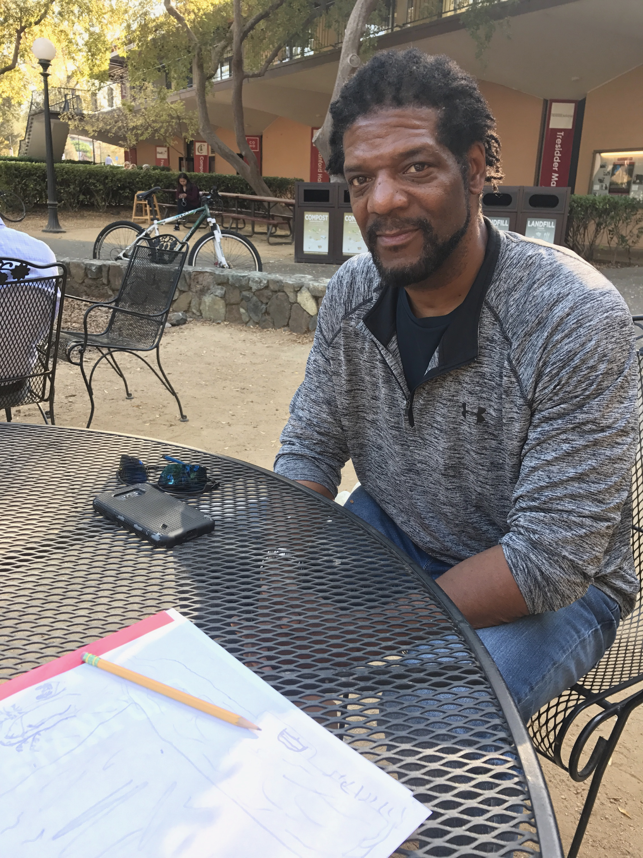
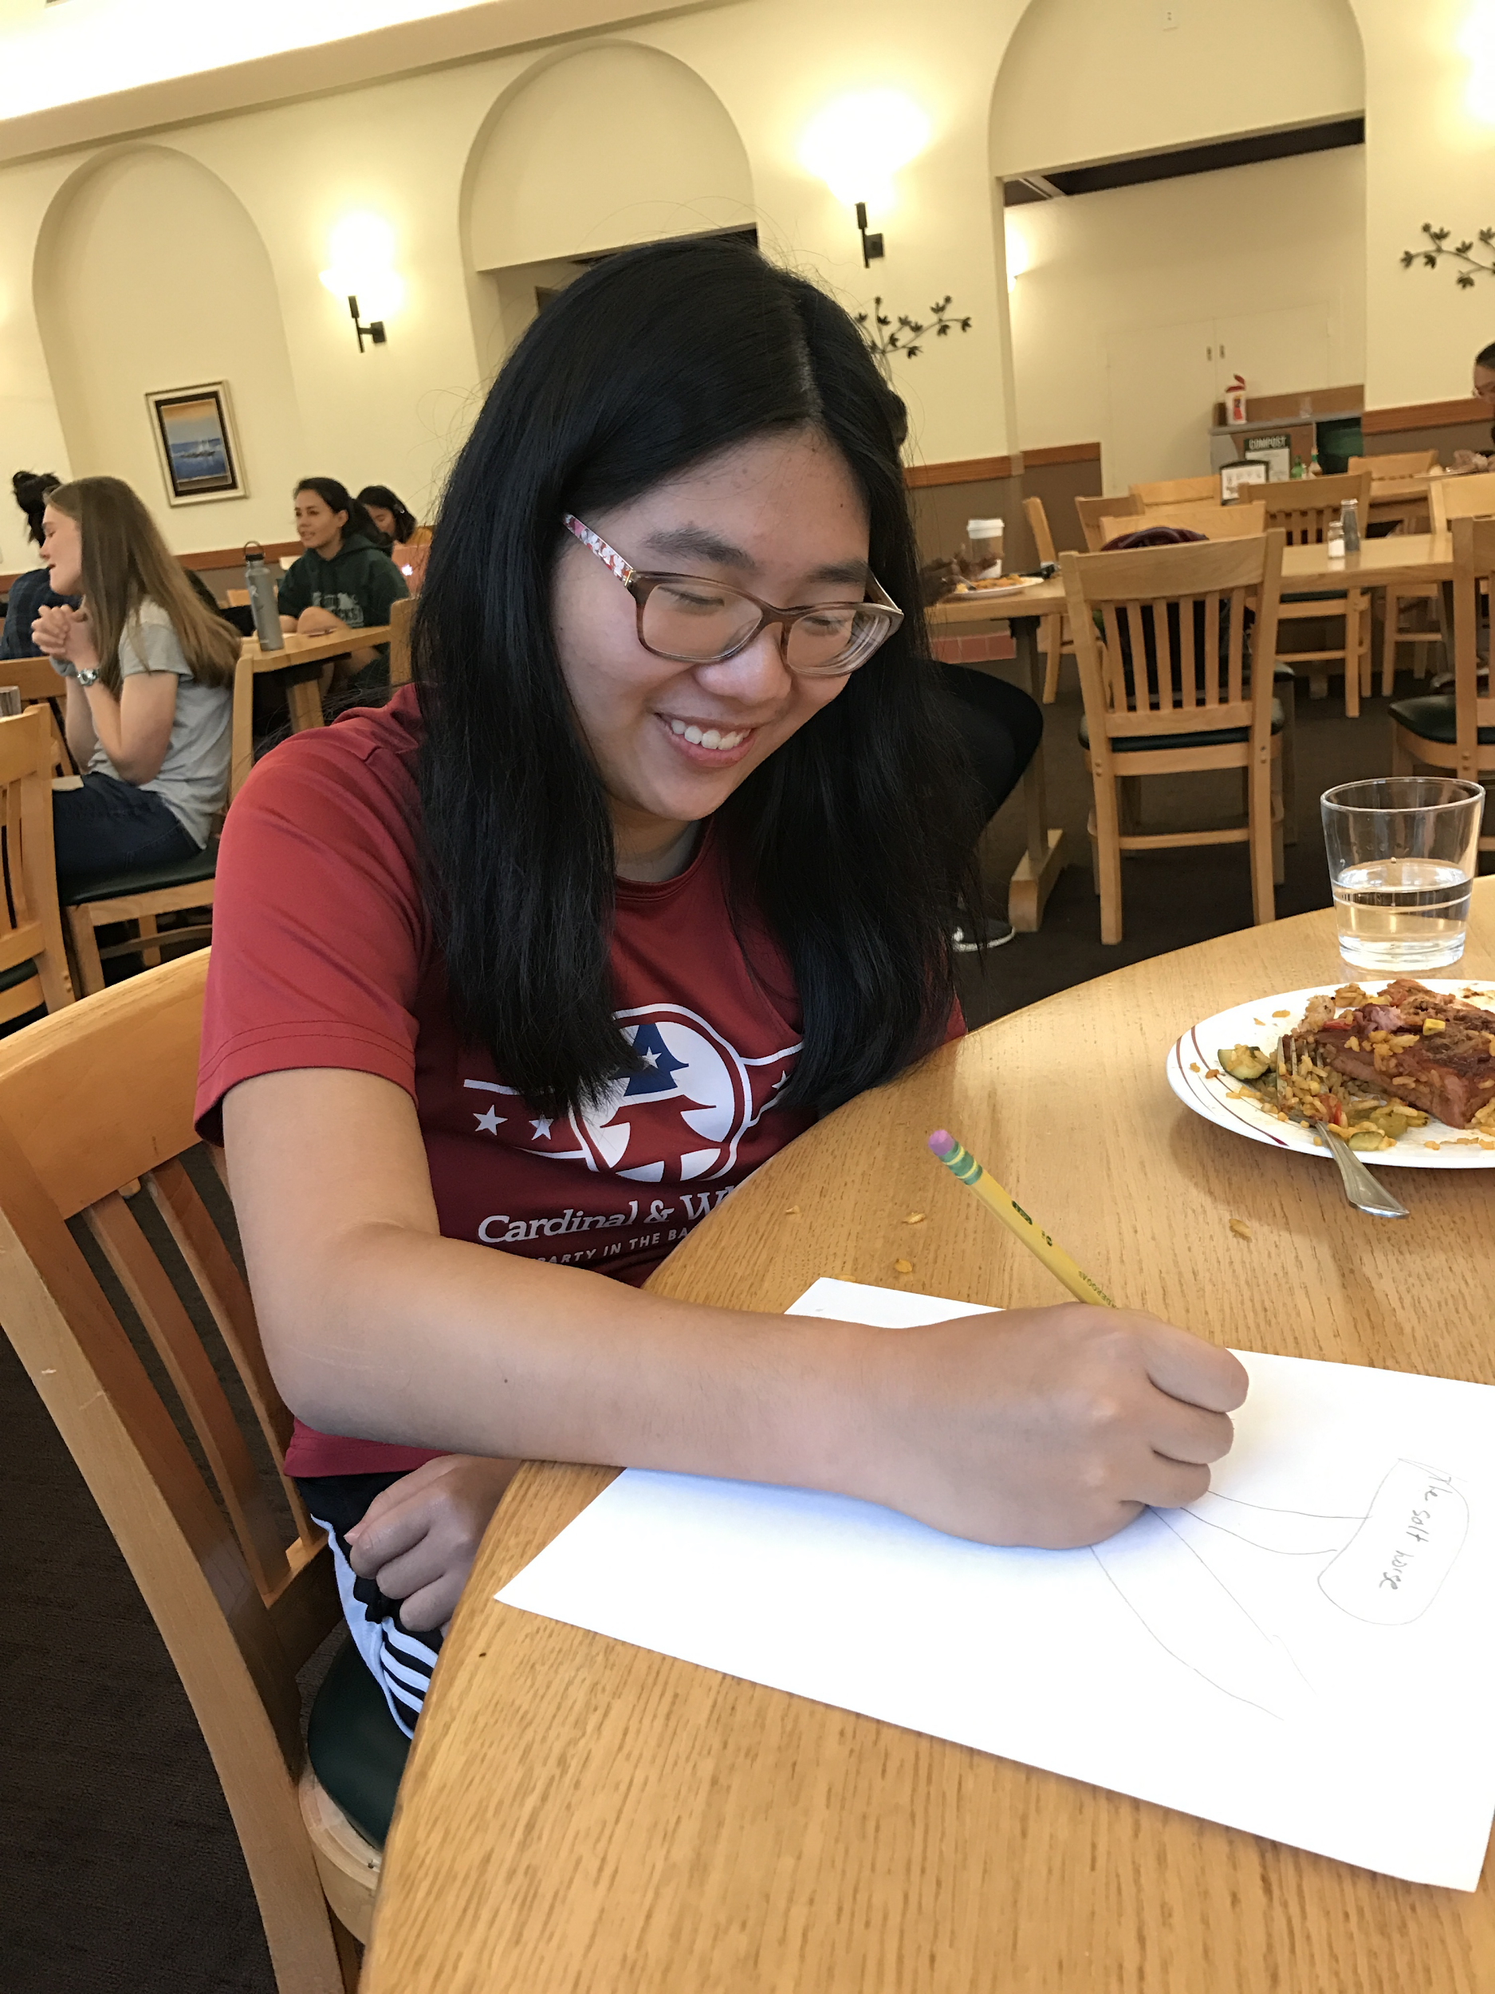
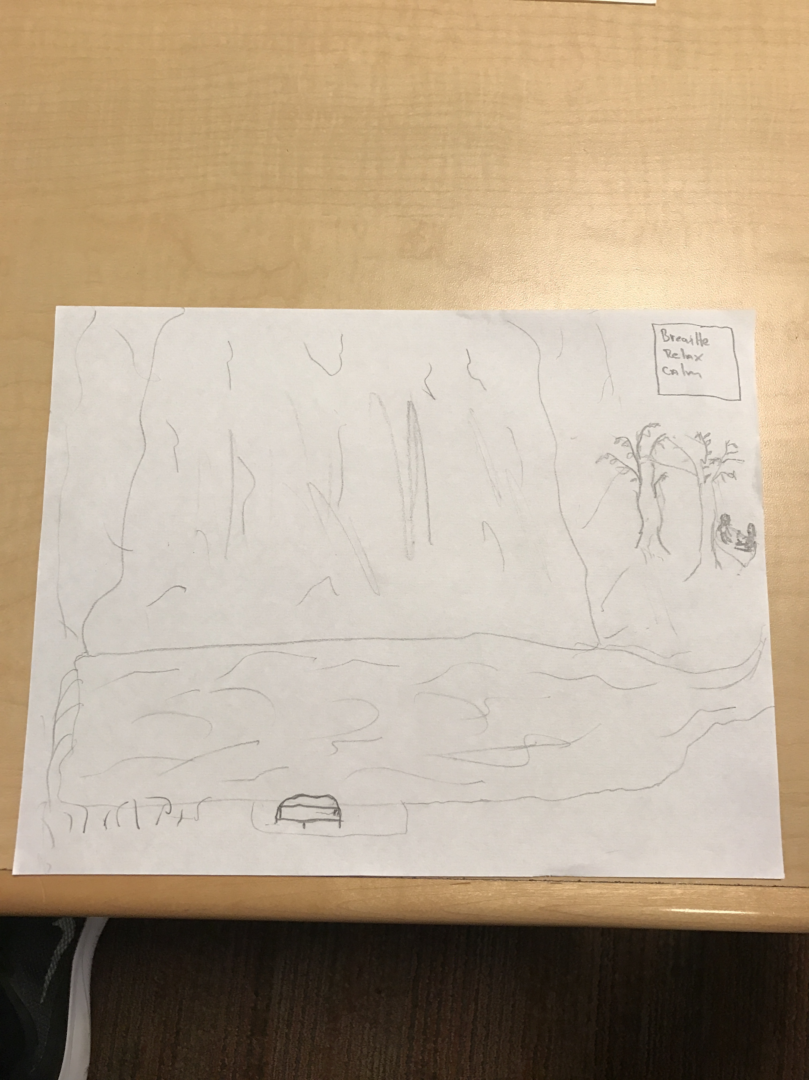
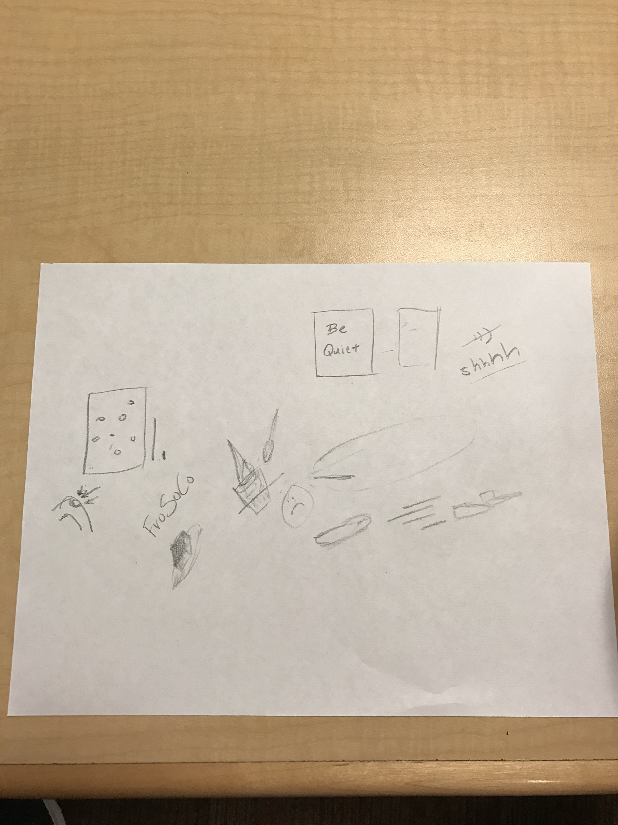
Notes:
Through emotional journey through time
The process of recall
happiest moment
- what do you do if you can’t rememeber
- are these memories still relevant

Slide 30
frictionless
reflective
open
The freedom to choose and mix different mediums led to a more meaningful and reflective process.
transparent
enjoyable
autonomy
optionality
Notes:
Through emotional journey through time
The process of recall
happiest moment
- what do you do if you can’t rememeber
- are these memories still relevant

Slide 31
HMW: Incentivize people to consistently record experiences?
Gamify the memory recording process by showing users quantitative measures of their progress.
Assumption: Logging progress incentivizes more frequent recording.
Notes:
Through emotional journey through time
The process of recall
happiest moment
- what do you do if you can’t rememeber
- are these memories still relevant

Slide 32
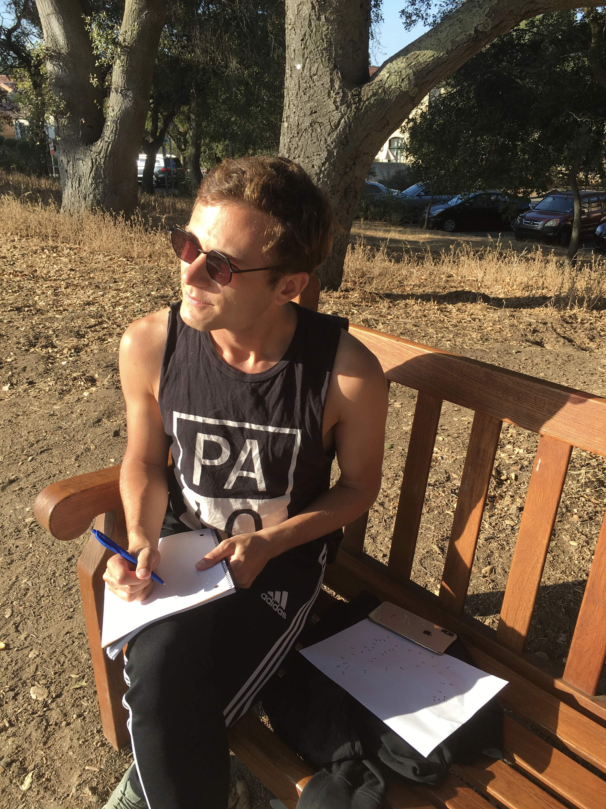
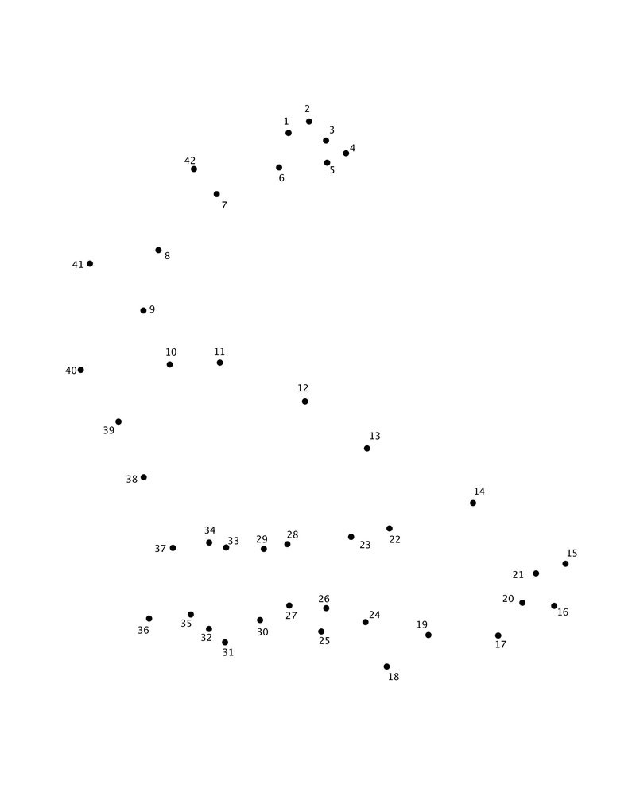
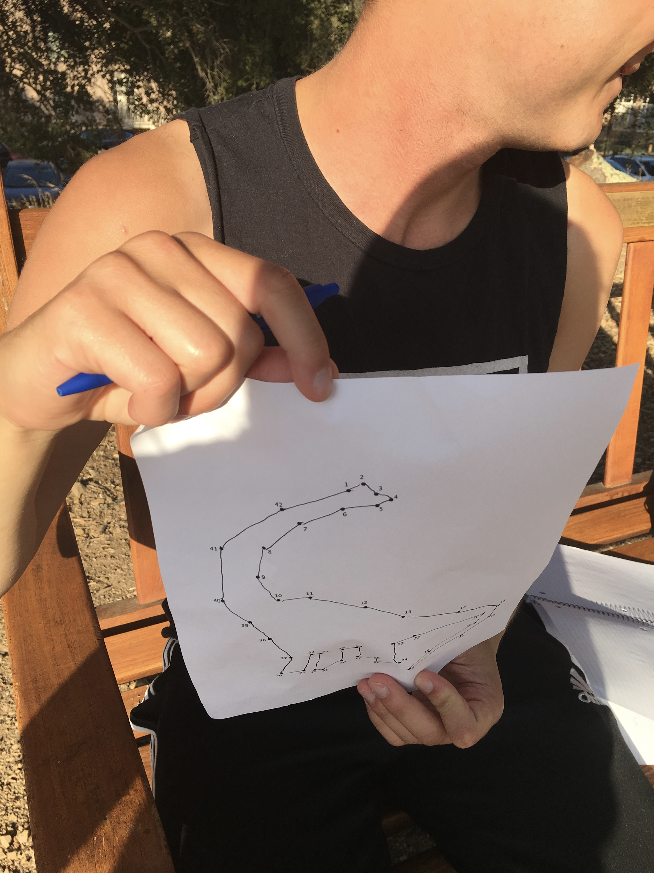
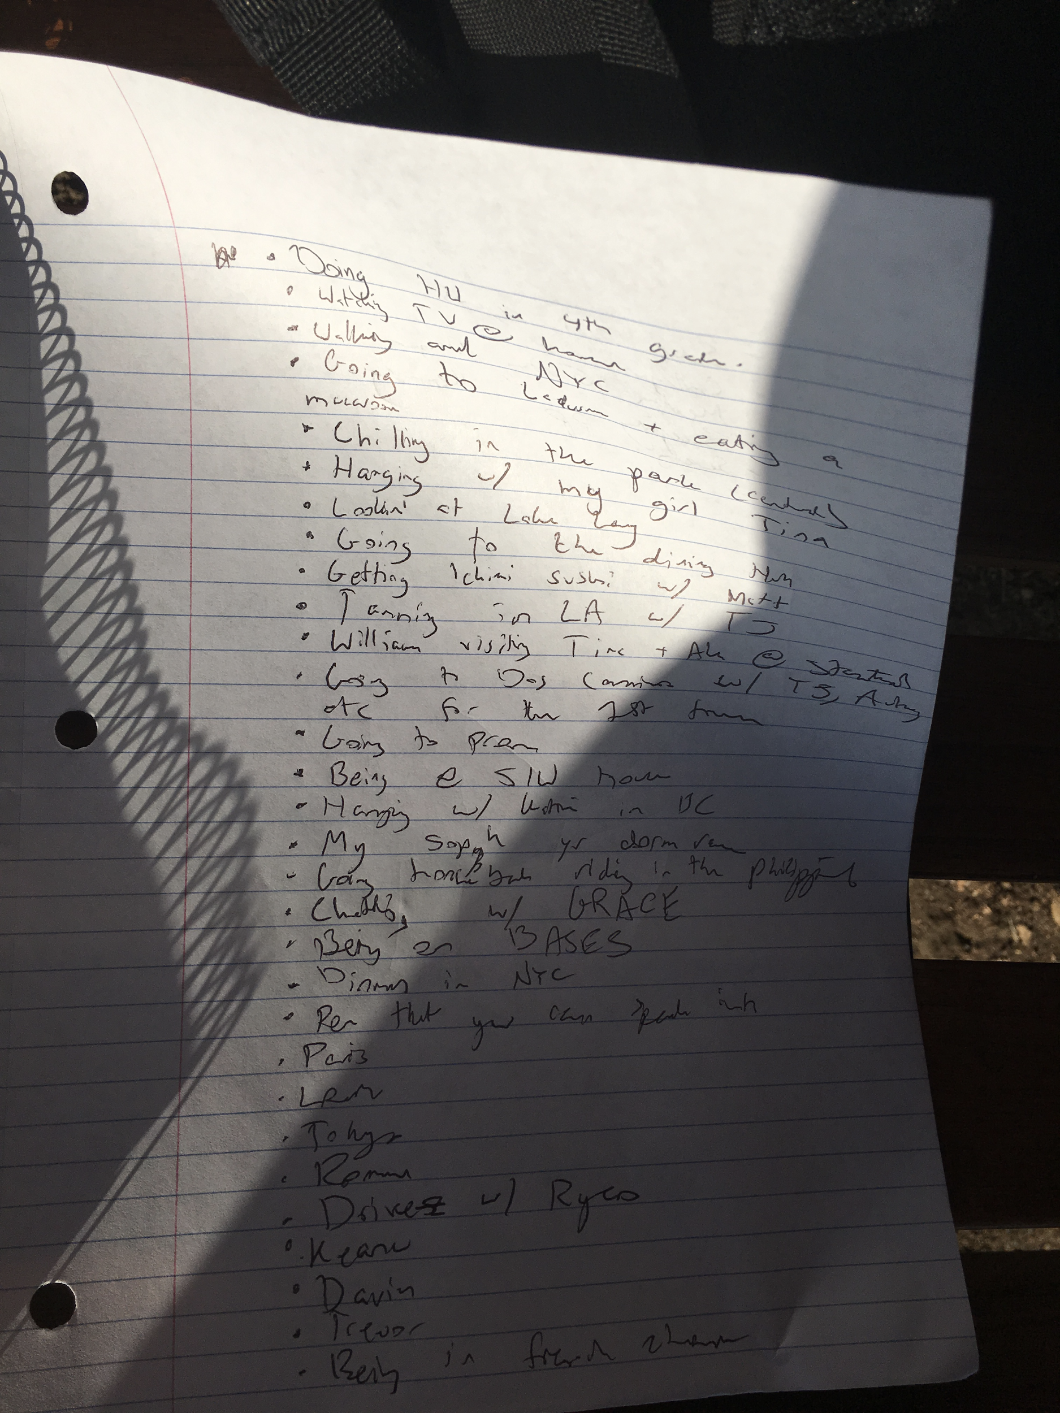
Notes:
Through emotional journey through time
The process of recall
happiest moment
- what do you do if you can’t rememeber
- are these memories still relevant

Slide 33
more memory recall
motivating
Gamifying the experience led to more frequent memory recall, although the intensity of the gamification interfered with the flow.
flow interference?
no temporal aspect?
Balance intensity
Notes:
Through emotional journey through time
The process of recall
happiest moment
- what do you do if you can’t rememeber
- are these memories still relevant

Slide 34
Summary
The time capsule is a nice addition, but not necessary
Tabula rasa was effective for engaging deep recall
Moderated gamification drives frequency
Further exploration of a gamified tabula rasa and ways to organize the resulting collected artifacts

Slide 35
Appendix
Notes:
We will first take you through our..
We interviewed four people total
<super fast>

Slide 36
Prototype Creation
Notes:
We will first take you through our..
We interviewed four people total
<super fast>

Slide 37
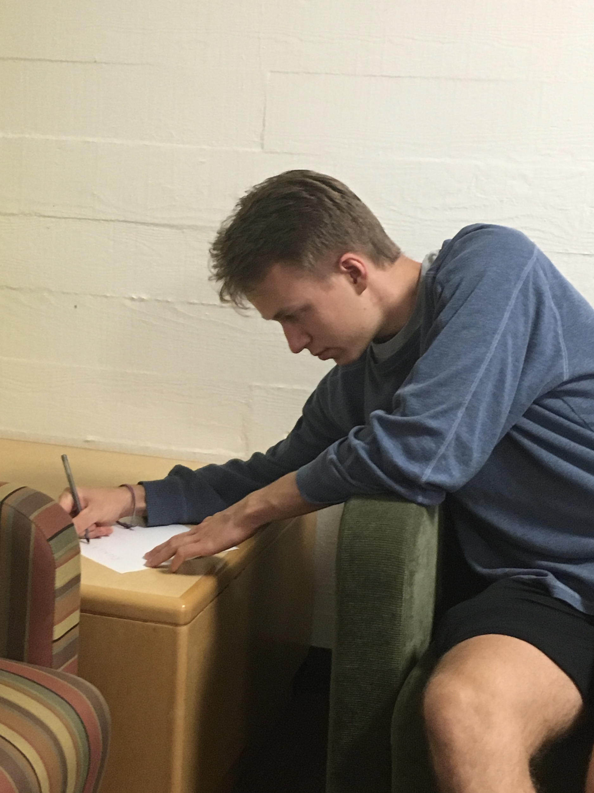
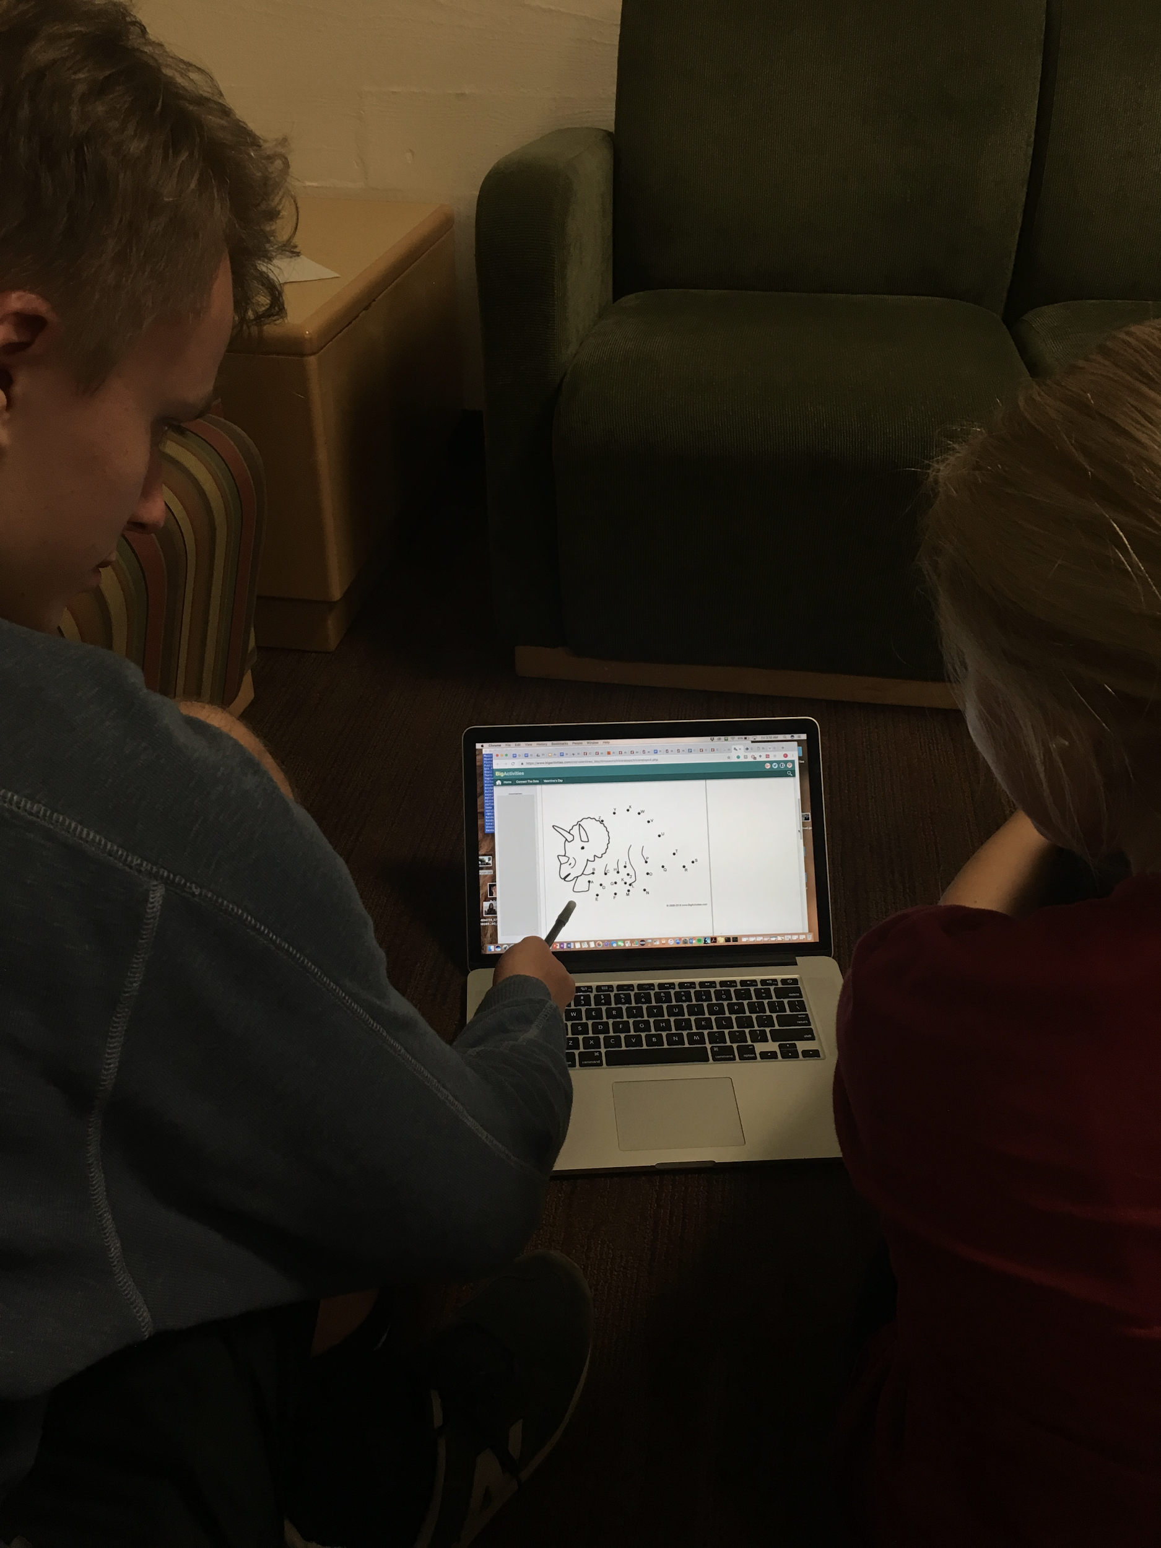
Notes:
Through emotional journey through time
The process of recall
happiest moment
- what do you do if you can’t rememeber
- are these memories still relevant

